Slide 1
AzureML Training
François Ponchon 11/03/2023 D3 YC+1
AzureML

Slide 2
Summary AzureML – Machine learning service
Goal of the presentation
Overview of main AzureML features
Introduction
AI and Image
Shearo Image - Use case
AzureML Architecture
Small Point Security / RG Management
Clone the git !
Configure Lab
Edit terraform Scripts
Run terraform scripts
AzureML Overview
AzureML Studio
JupyterLab
VS Code
Storage and Data
Filesystem
Data Assets
Datastore
AzureML Jobs
Environment
EntryScript
Pipeline Script

Slide 3
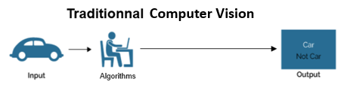
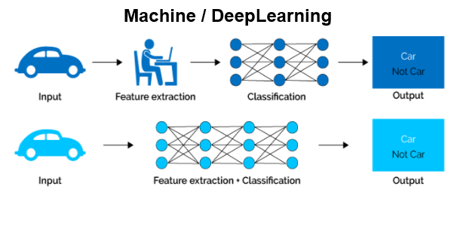
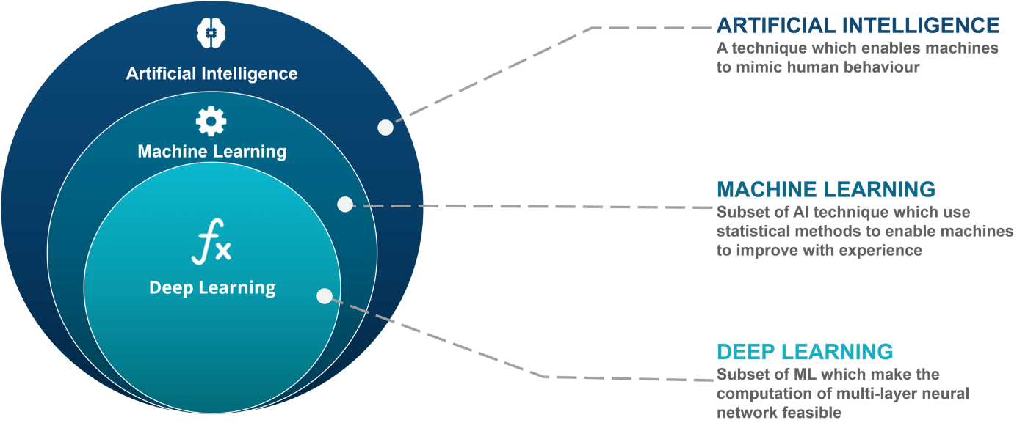
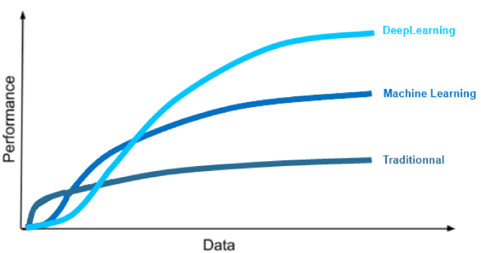
DeepLearning A little part of AI
Today, we’ll focus on DeepLearning applyed to images

Slide 4









What is an image ? An image is a [H,W,C] matrix
In every day life :
Some examples in Michelin Industrial Life :
Jpeg Incompatible
Shearography – (Visible + Interferences (H,W,2))
Profilometry – (Visible + Depth (3D), (H,W,2))
XRays – (H,W,1)

Slide 5

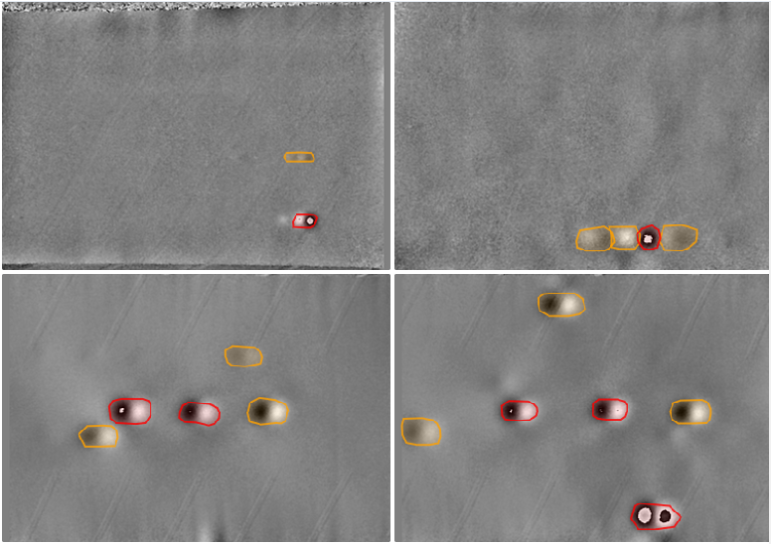
What we’ll do during this training ? Create a training pipeline for Mnist and Shearo IA
Implement a workflow :
MNIST - Dataset
Shearo - Dataset
AzureML Training
Data Gathering
Data Labelling
Design Algorithms
Training
Acquisitions
Deployment
Feedback Loop
Out of scope :
Labelling pipeline
Model Deployment

Slide 6
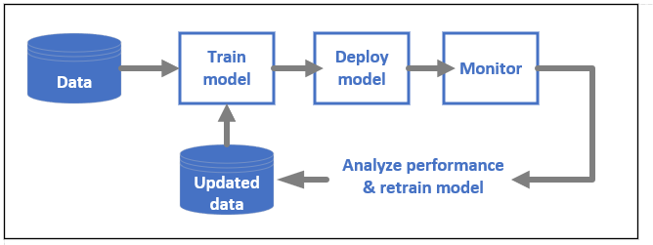
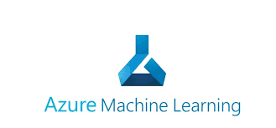
What is Azure Machine Learning ? AzureML is a Microsoft cloud service for Accelerating and Managing ML Project Lifecycle
AzureML is able to manage every part of ML project Lifecycle https://learn.microsoft.com/en-us/azure/machine-learning/overview-what-is-azure-machine-learning

Slide 7
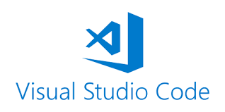

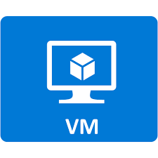


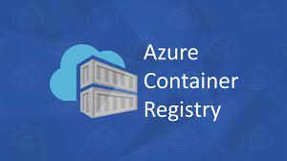
What is Azure Machine Learning ? AzureML is a Microsoft cloud service for Accelerating and Managing ML Project Lifecycle
AzureML is build on top of other cloud services.
IDE Integration
Store Code and Results
Monitoring
Compute Instance
Store Secrets
Compute Cluster
Store Docker Environments

Slide 8

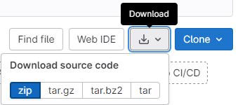
Clone the gitlab repository In order to get started
If you configured git :
If not :
In order to get reproductible paths we can download data in C://BUSCODE
>>> git clone
>>> cd azureml-training
>>> code .

Slide 9
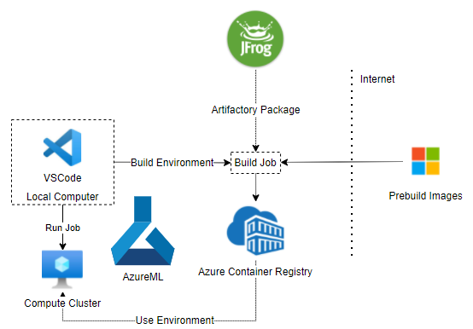
What we’ll learn today Launch Pipelines with AzureML in order to train your computer vision model.
What you’ll do today :
Dev here
Launch jobs here

Slide 10
AzureML Overview
Michelin / Computer Vision

Slide 11
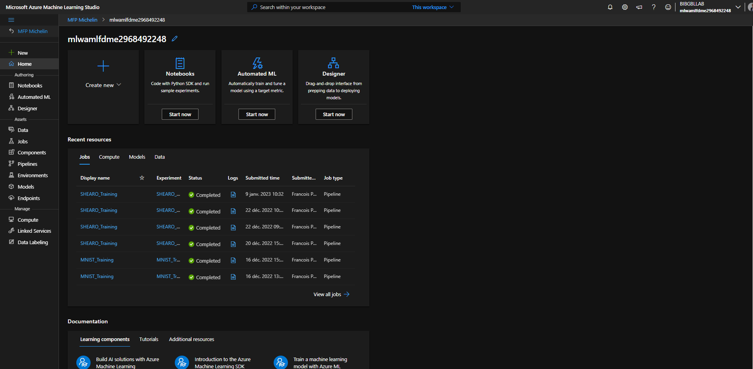
AzureML Studio IN azureML Studio, we can see a lot of things
Training Scope

Slide 12
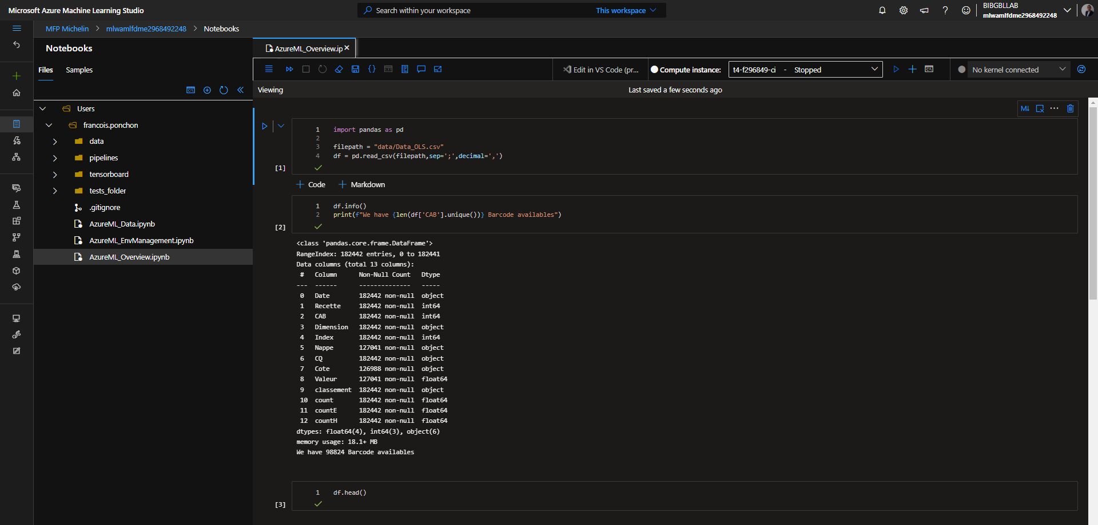
AzureML Studio In the notebook part, we can see some kind of filesystem
Here you can work with notebook but the IDE is obviously perfectible.
Can you run the code of the notebook ?

Slide 13
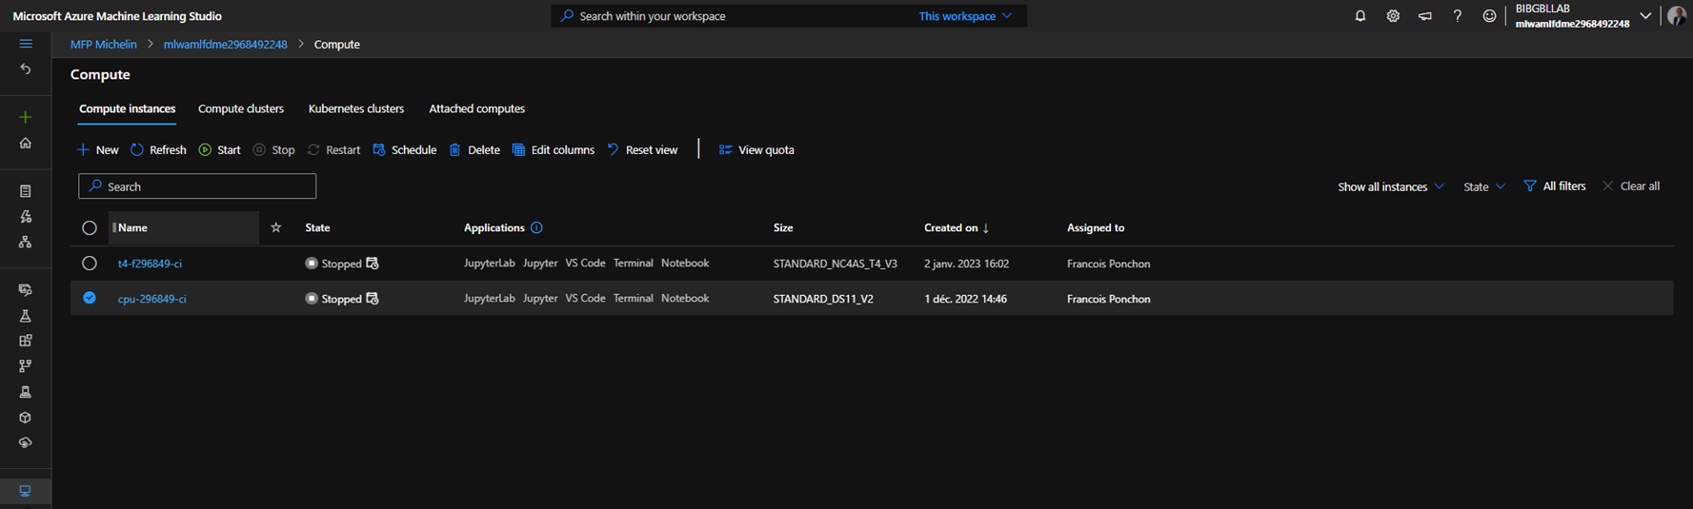


AzureML Studio - Compute In order to run code, we need a compute instance, for that, we create in in a compute tab
Good practices :
Schedule your compute instance in order to Stop in the evening
Schedule your compute instance to stop every morning
Dimension the compute instance regarding your requirements
D2 Specific – create your compute instance on the same Vnet than the storage account

Slide 14
AzureML Studio – Compute Instance vs Cluster What is the difference ?
When we developp on an instance, we pay while the machine is started, the cluster is billed only the time we use it.
 | Compute Instance | Compute Cluster
MultiNode
MultiUser
Auto Scale
RealTime Debug
Pipeline compatible
Launch & Forget
Low code HMI
Main Usage | DEV | JOBs
Very convenient for long and recurrent jobs

Slide 15
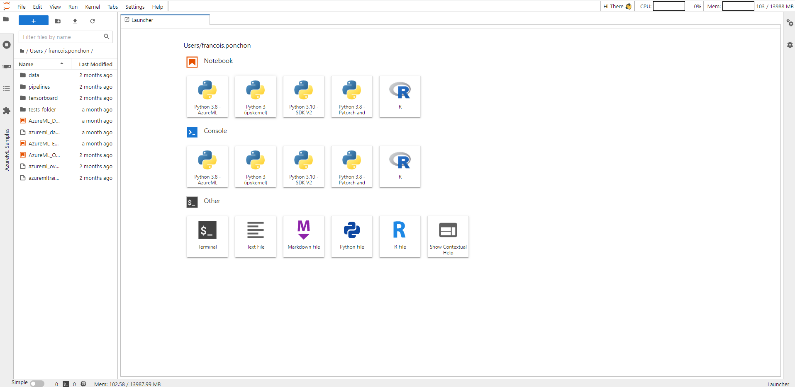
AzureML - JupyterLab From the compute instance, we can open a jupyterlab
Good practices :
Run long jobs on compute clusters

Slide 16
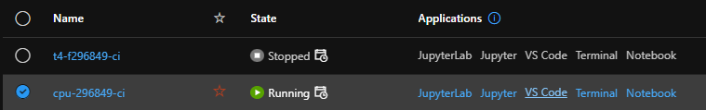
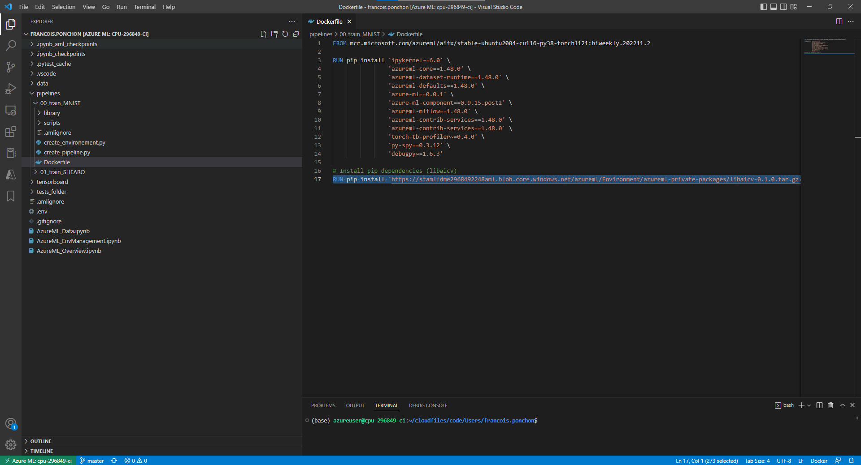


AzureML - VSCode From the compute instance, we can open vscode
Good practices :
Move in your own directory (cd Users/firstname.name | code .)
Install Docstring/Python Extensions
Use debugger
Coup de cœur Formateur

Slide 17
Storage and data
Michelin / Computer Vision

Slide 18
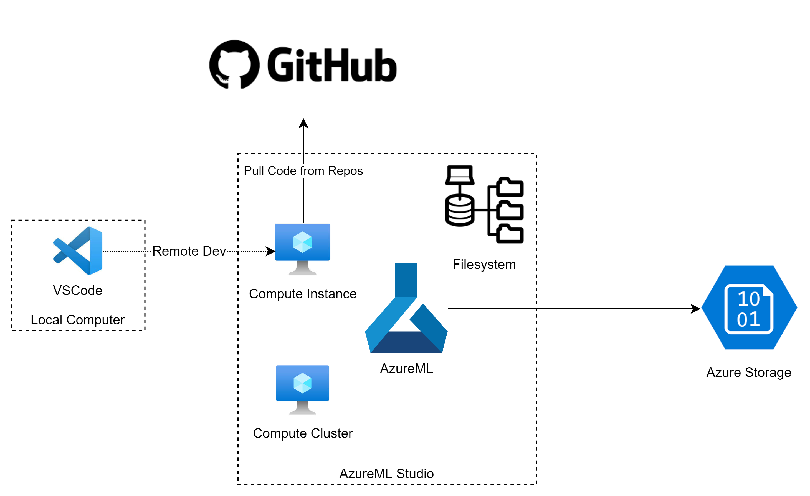
Azure ML - Data different ways to load data…
You can load data in many différent places :
Store in AzureML filesystem (near your code)
Store in Azure storage (In a dedicated container)
 | Filesystem | AzureML Data | Dedicated Storage
Large Files | --- | / | +++
A lot of files | --- | - | +++
Single CSV file | / | ++ | / Overkill

Slide 19
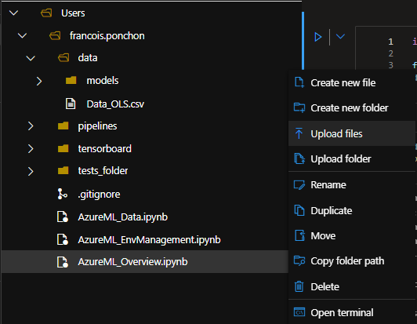
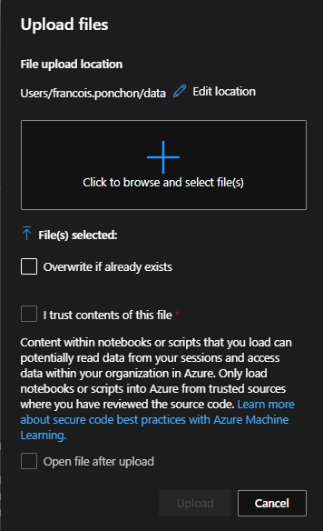
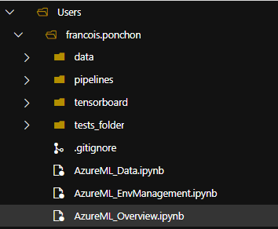
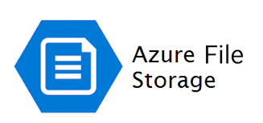
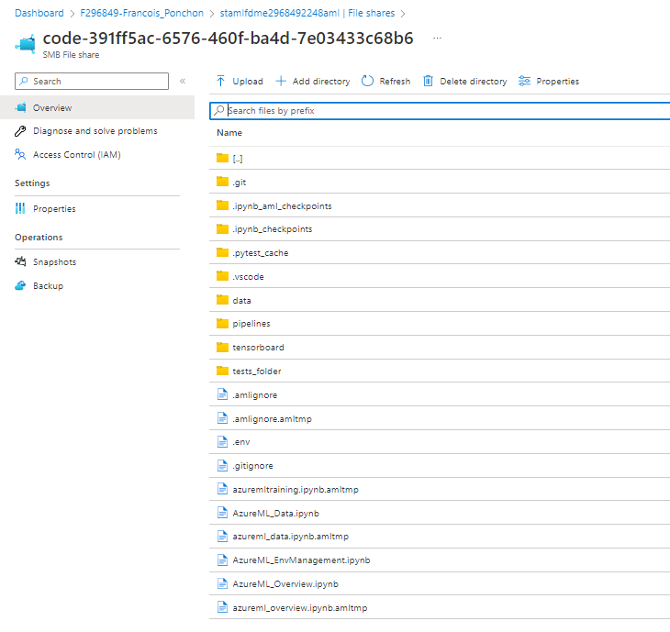
Upload data in the filesystem The « dirty » way
You can take your file, and put it near your code.
Why is it dirty ?
If you create a pipeline it will copy everything in the pipeline snapshot. => Long to start and limited to 300Mo by default.
Behind the hood
Good practices :
Declare path in your .gitignore
Declare path in your .amlignore

Slide 20
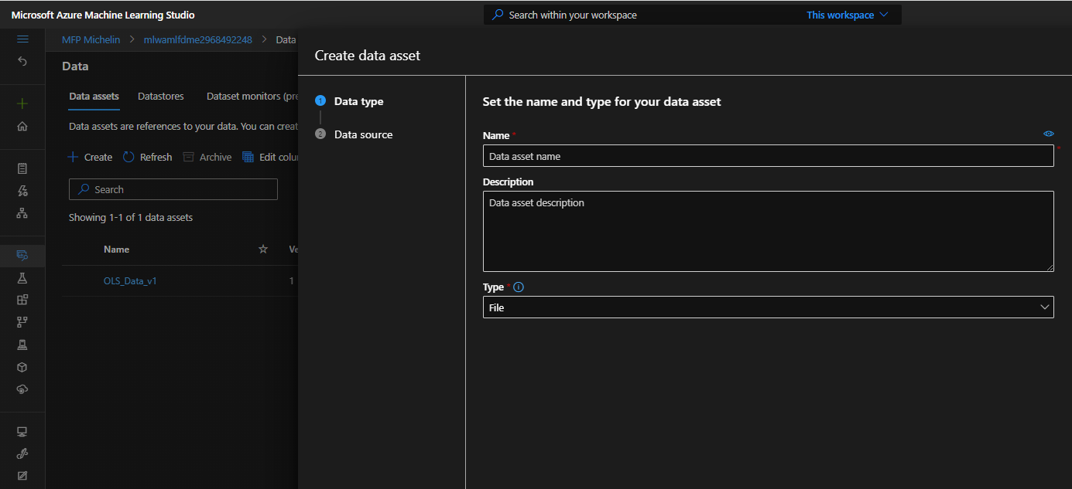
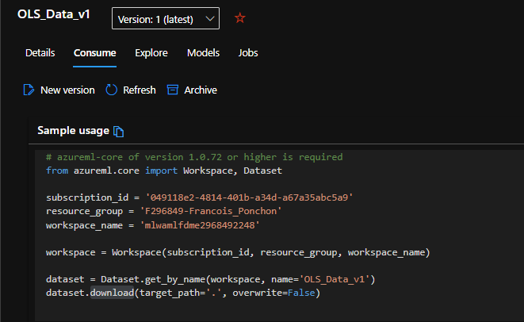
Upload data Assets Ideal if you don’t have a lot of files
You can take your file, and put it near your code.
Limitation
If you have thousands of files it will be a little complicate to consume it. But largelly enough if you work on data processing pipelines consuming several csv.
Consumption
DEPRECIATED (SDK V1)
Good practices :
Don’t download during debug
Behind the hood
Azure FileShare
The only difference with uploading in your filesystem is that the file is created in another fileshare.

Slide 21
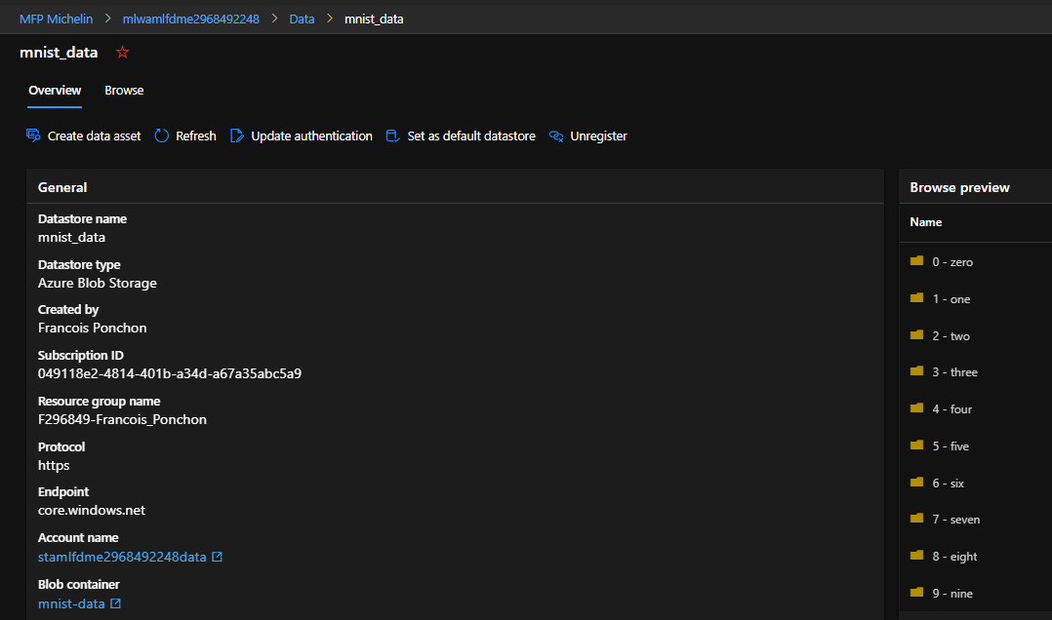
Store data in datastores Ideal if you have a lot of files (exemple : Computer vision usecases)
You can take your file, and put it near your code.
Limitation
You need to mount the storage to debug. It needs a special piece of code / script.
Good practices :
Don’t download during debug

Slide 22
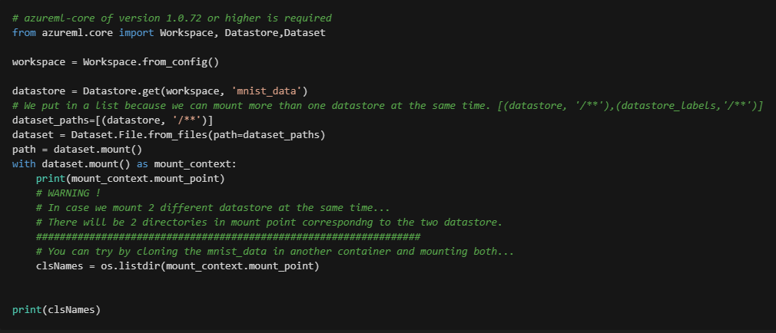
Consume data from datastores data assets (like in AzureML pipelines)
With several commands, it is possible to mount the datastore by the code
DEPRECIATED (SDK V1)
Behind the hood
Azure Blob Storage
It’s no longer a filesystem. It only looks like when we consume it.
The code mount the datastore each time we run it.

Slide 23
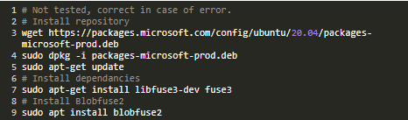
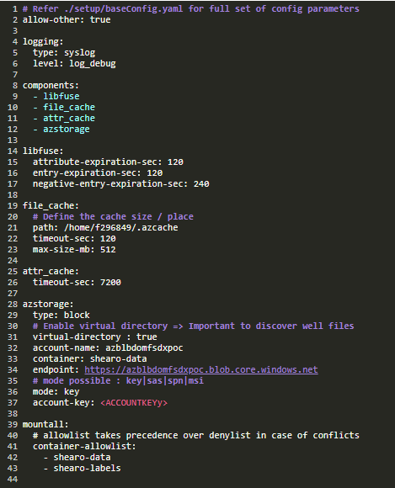
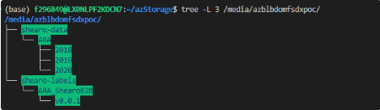
Consume data from datastores Fuse – A library to mount datastore as a filesystem
With several commands, it is possible to mount the datastore by some scripts. The advantage is that it is persistant. https://michelingroup.sharepoint.com/sites/ExplorationManufacturing/SitePages/Mount-AzStorage-(Fuse).aspx
Install
Create Directories
Mount
Config
Behind the hood
Azure Blob Storage
It only looks like a filesystem.
We only have to mount when restarting compute instance.
Coup de cœur Formateur

Slide 24
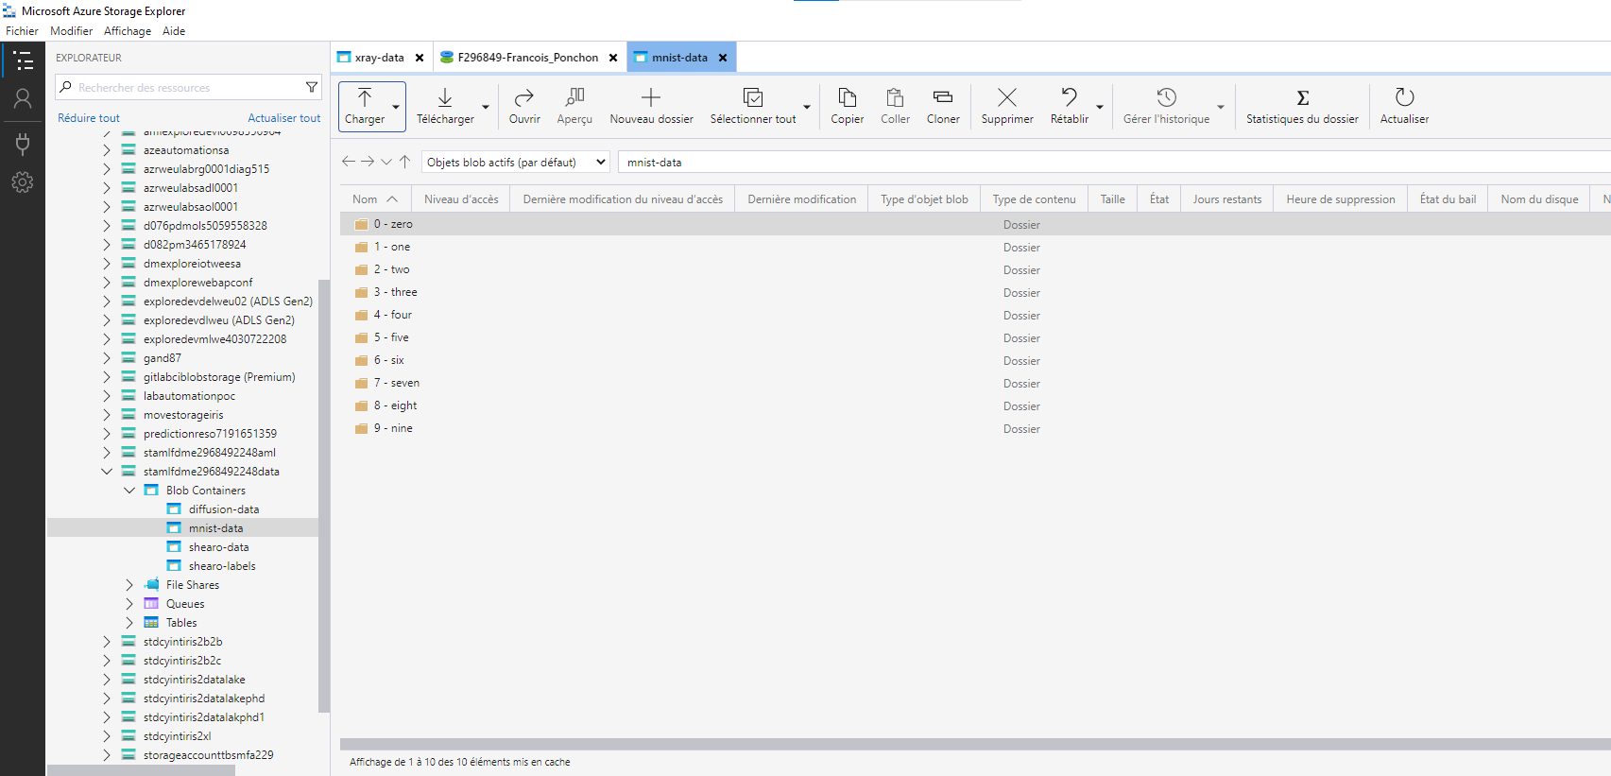
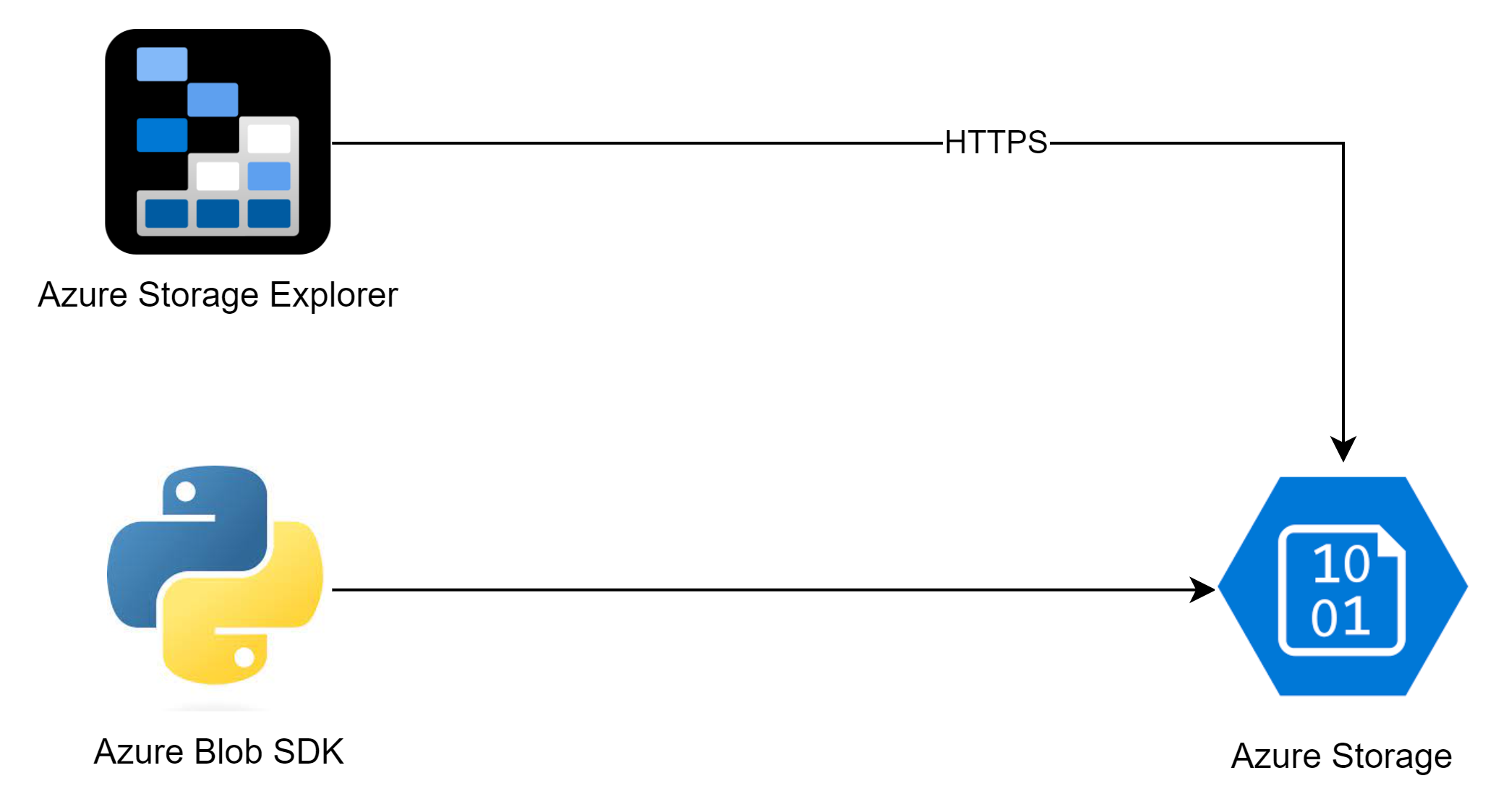
How to upload data in a datastore ? We can use azure storage explorer
Installation Procedure
https://michelingroup.sharepoint.com/sites/ExplorationManufacturing/SitePages/Microsoft-Azure-Blob-Storage_fr.aspx

Slide 25
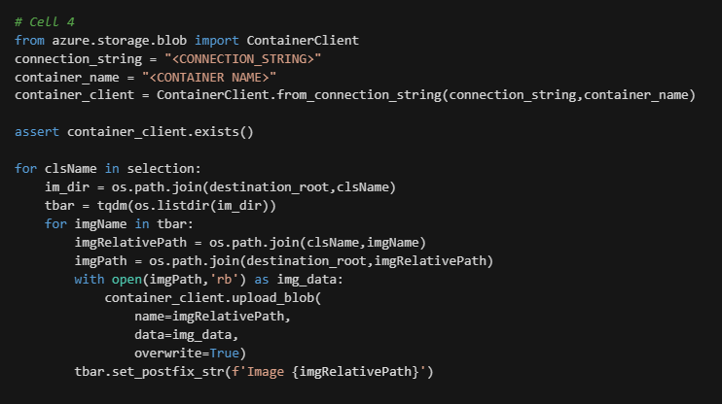
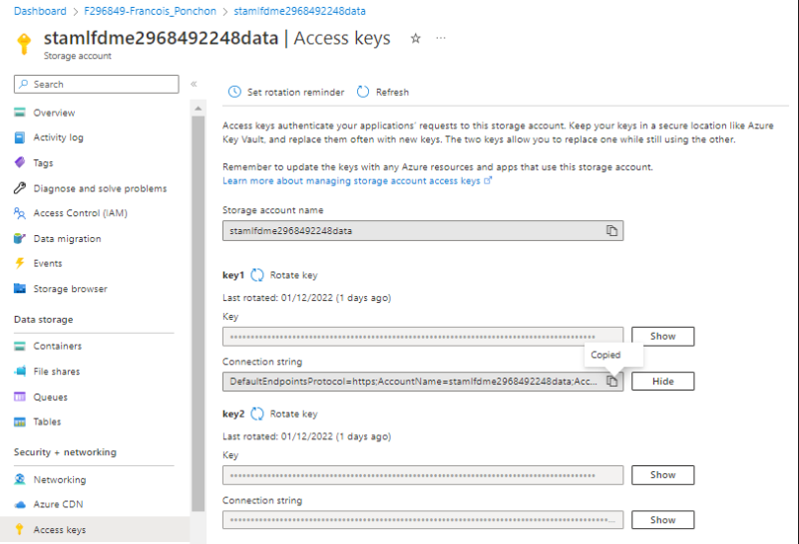
How to upload data in a datastore ? We can use azure Blob SDK
With azureblob SDK we can create a container client to upload there our data :
Upload
Good practices :
Do not keep connection strings in your files.
Create a naming convention
Use SaS token to have fine right management
Coup de cœur Formateur

Slide 26
AzureML Jobs
Michelin / Computer Vision

Slide 27
AzureML Studio – Compute Instance vs Cluster What is the difference ?
When we developp on an instance, we pay while the machine is started, the cluster is billed only the time we use it.
 | Compute Instance | Compute Cluster
MultiNode
MultiUser
Auto Scale
RealTime Debug
Pipeline compatible
Launch & Forget
Low code HMI
Main Usage | DEV | JOBs
Very convenient for long and recurrent jobs

Slide 28
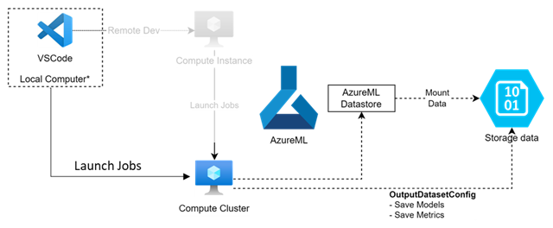
How to launch a job in AzureML We use a « launch » script
From the compute instance, we run a script that will run the job
But there is different sub-steps.

Slide 29
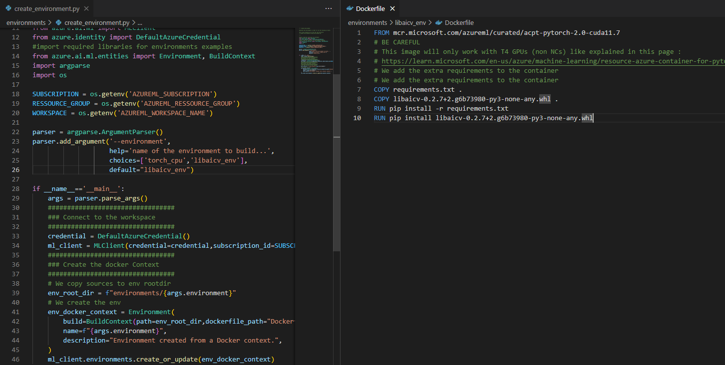
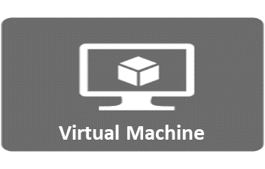
Create the environment Where the code will run
In order to run the pipeline, we’ll need :
An environment
Environment
Create Run environment

Slide 30
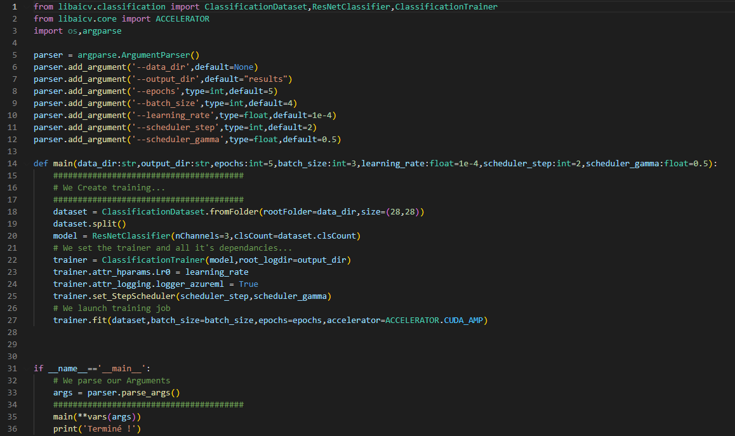
Create an entry script In this example, we
In order to run the pipeline, we’ll need :
An environment
An entry Script
Argparse for arguments
Code to train
Entry Script
Environment

Slide 31
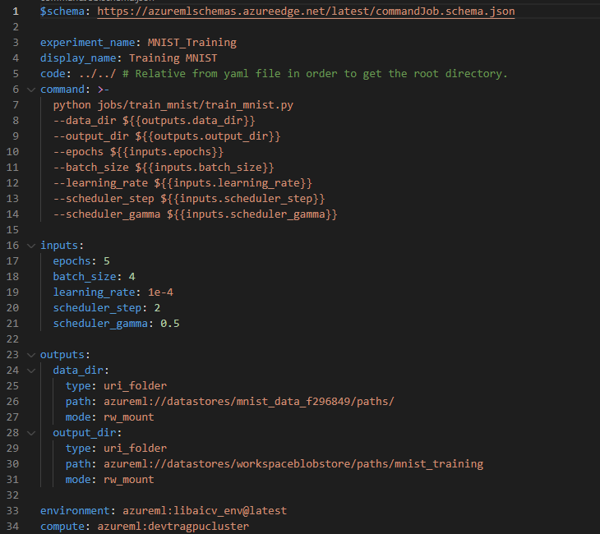
Create the pipeline Launcher This file will run the entry script on a target with the env
In order to run the pipeline, we’ll need :
An environment
An entry Script
A Pipeline Launch Script
Define EntryPoint + Arguments
Pipeline Launch
Define Input / Output
Entry Script
Environment
Define Environment + Machine

Slide 32
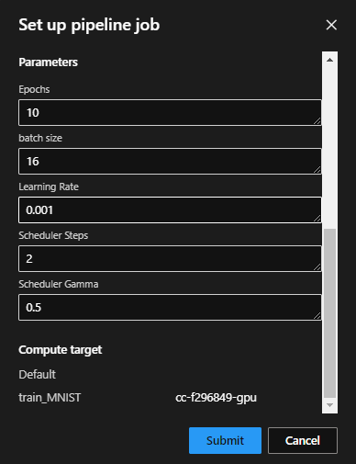
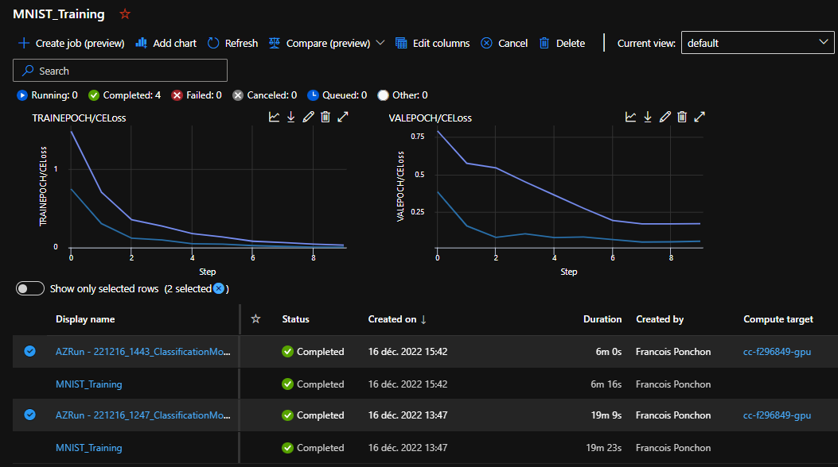
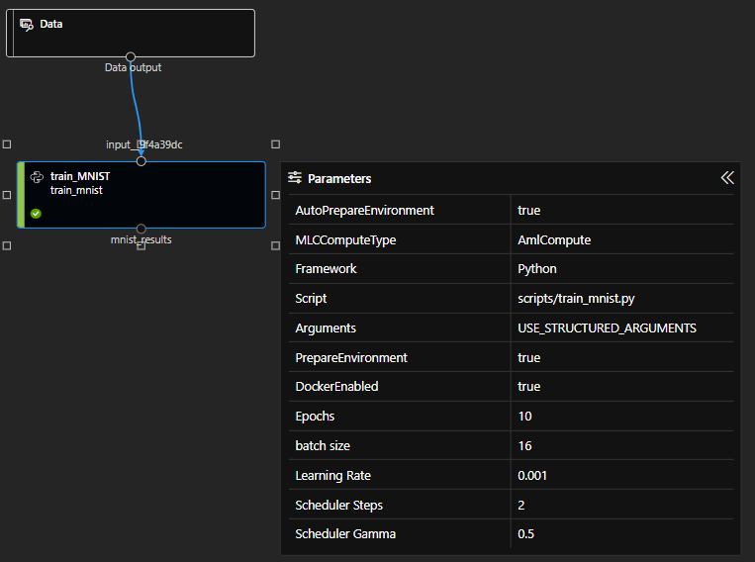
Training Mnist job We are able to see what happens in the job
In order to run the pipeline, we’ll need :
An environment
An entry Script
A Pipeline Launch Script
1 - List Run Jobs
3 – Resubmit if needed !
2 – View Run Parameters
It is also possible to schedule Pipelines.

Slide 33
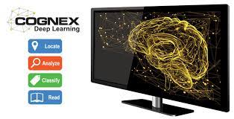
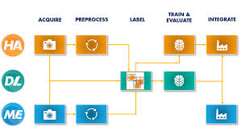


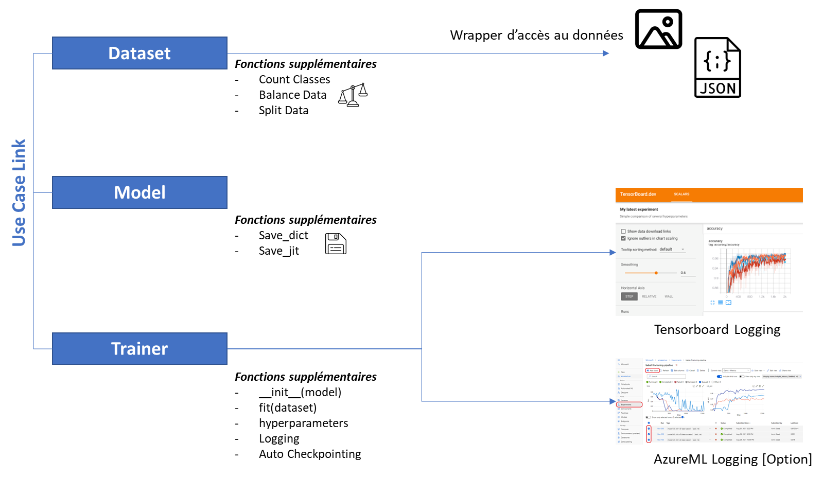
Focus Libaicv With this library you are able to train models easily in Azure
Landscape of Computer vision tools
Cognex ViDi
HALCON Suite
AzureML / Python
Packaged Low Code
More accessible
Custom Full Code
More flexible
More Expert
AMBITION
Create a library that allows to easily train models
Use cases :
Semantic segmentation
Classification
Detection (IN PROGRESS)
Instance Segmentation
Self-Supervised Learning
Diffusion

Slide 34
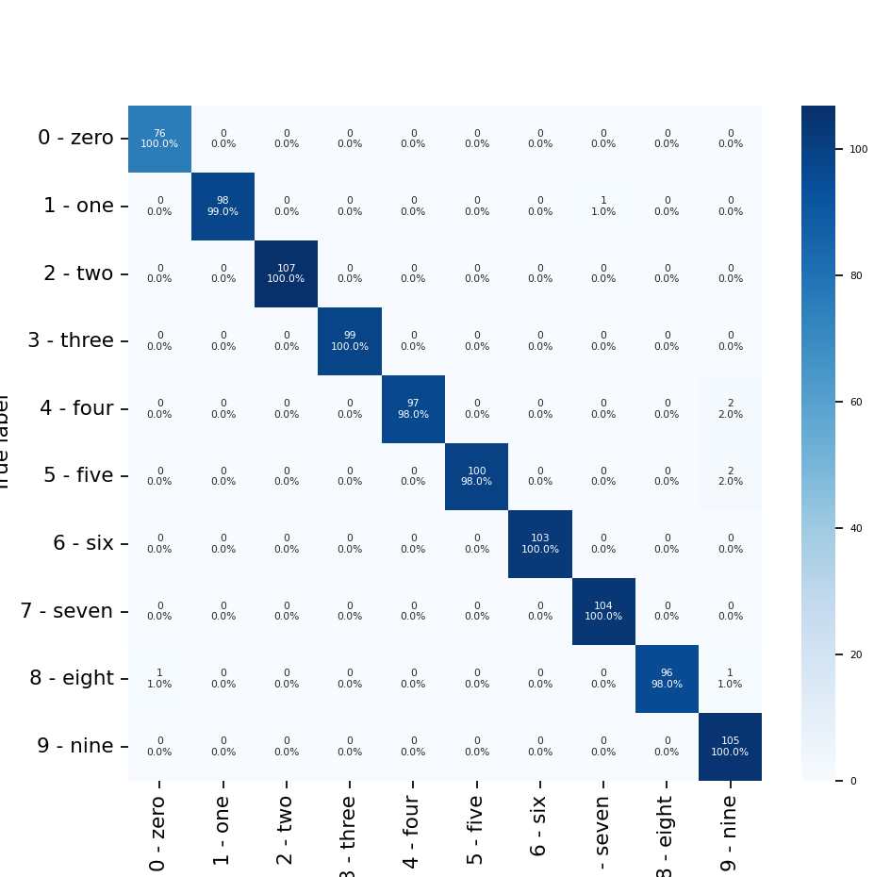
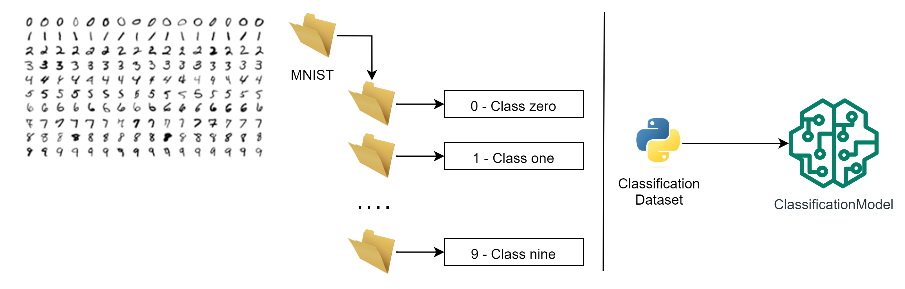
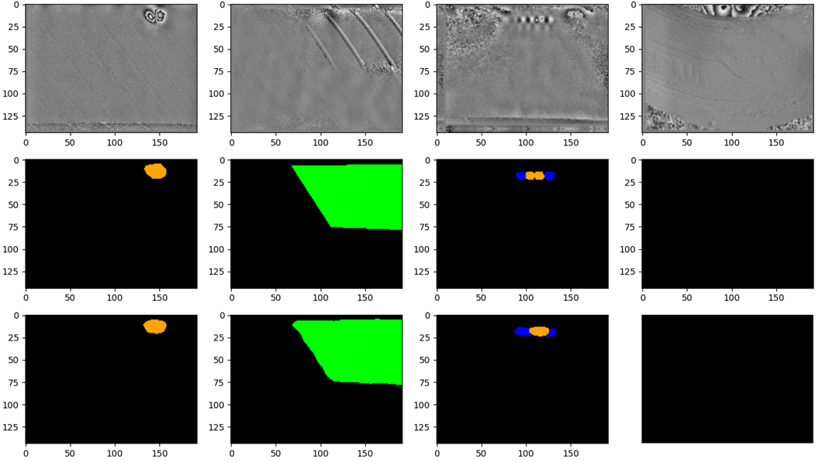
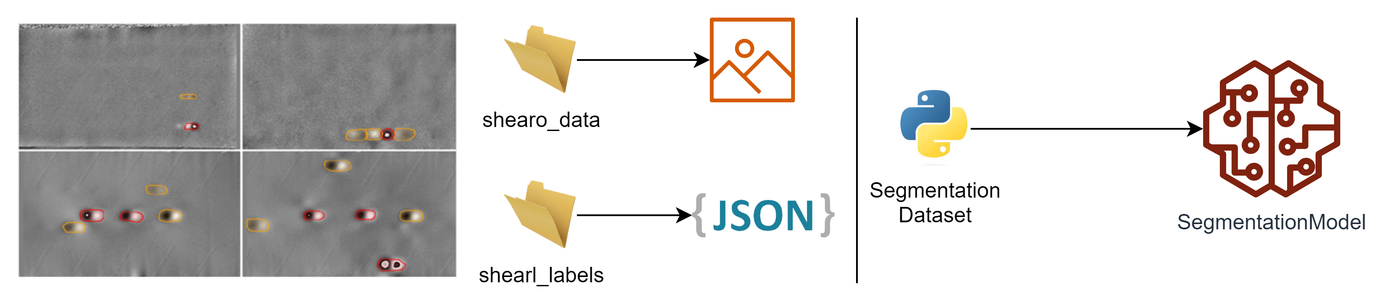
Use case explaination MNIST / Shearo IA
MNIST From folder classify the right class
ShearoIA From folder classify the right class

Slide 35
Thanks for attending !
Michelin / Computer Vision

